Slide 1
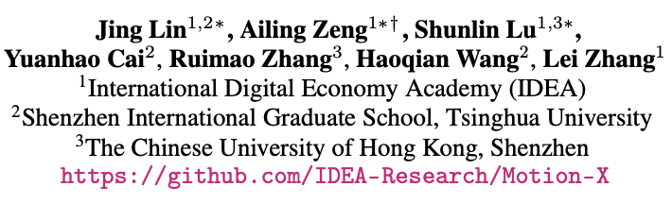
Motion-X: A Large-scale 3D Expressive Whole-body Human Motion Dataset

Slide 2
Contributions
• We propose a large-scale expressive motion dataset with precise 3D whole-body motions and corresponding sequence-level and frame-level text descriptions.
• We elaborately design a automatic motion and text annotation pipeline, enabling efficient capture of high-quality human text-motion data at scale.
• Comprehensive experiments demonstrate the accuracy of the motion annotation pipeline and the benefits of Motion-X in 3D whole-body motion generation and mesh recovery tasks.

Slide 3
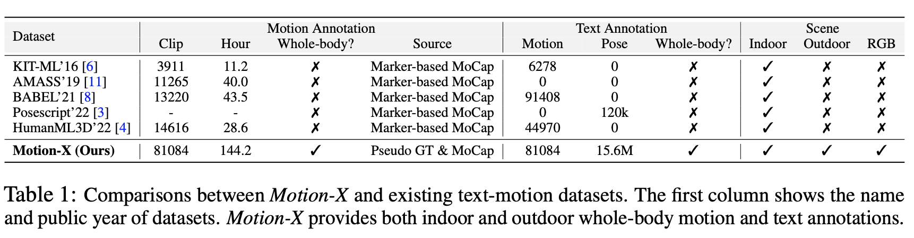
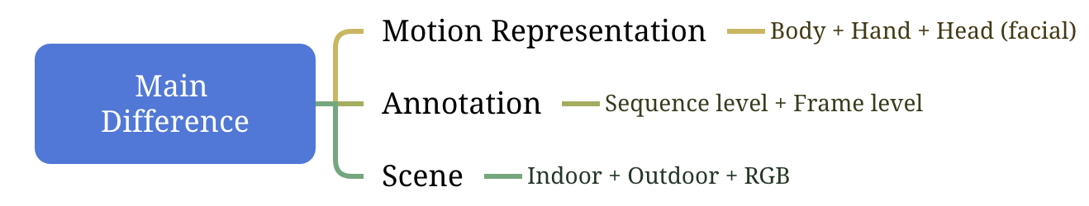
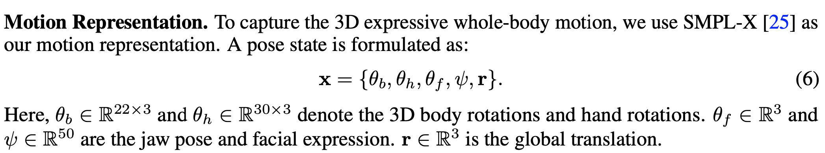
Whole-body Human Motion

Slide 4
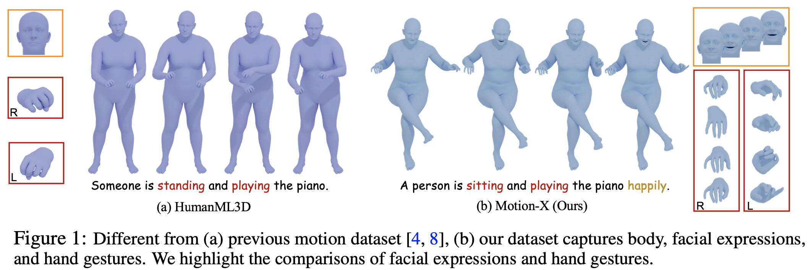
Data Example

Slide 5
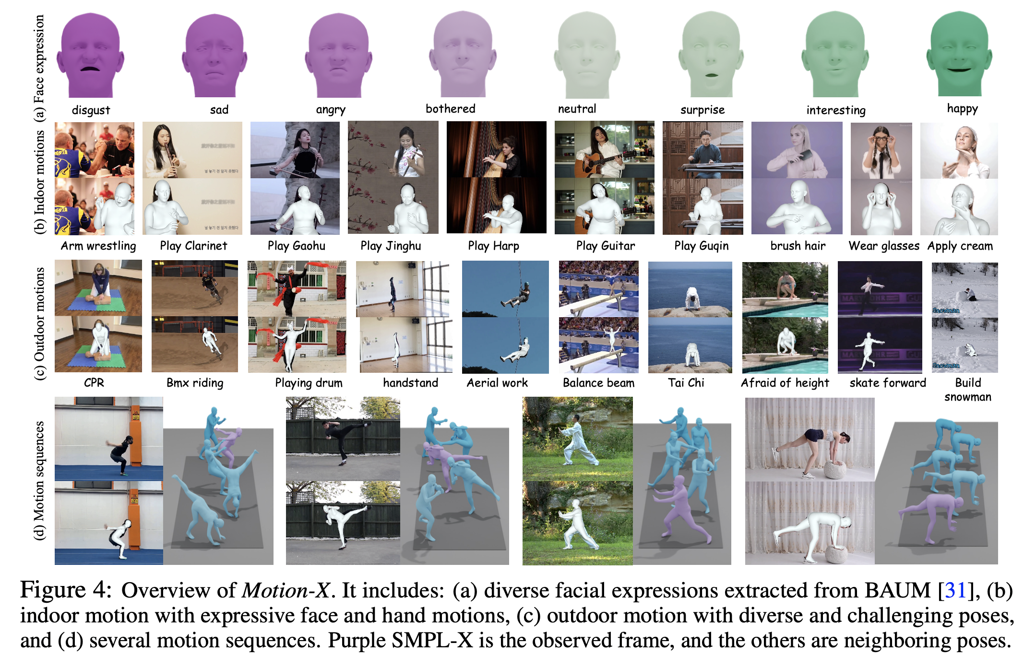
Data Example

Slide 6
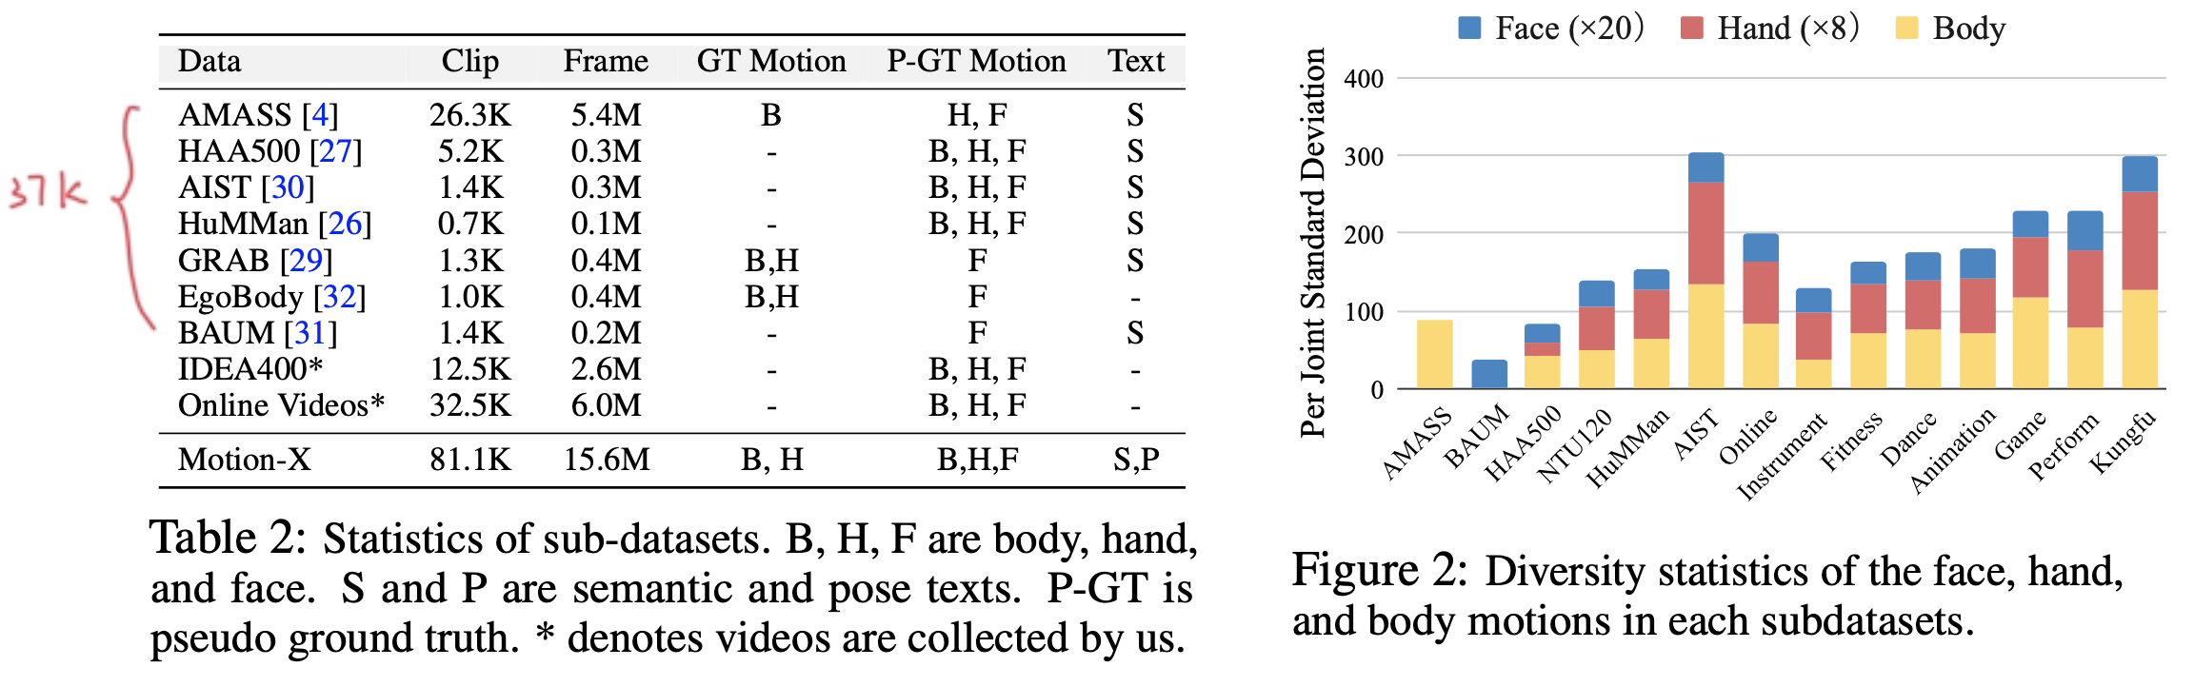
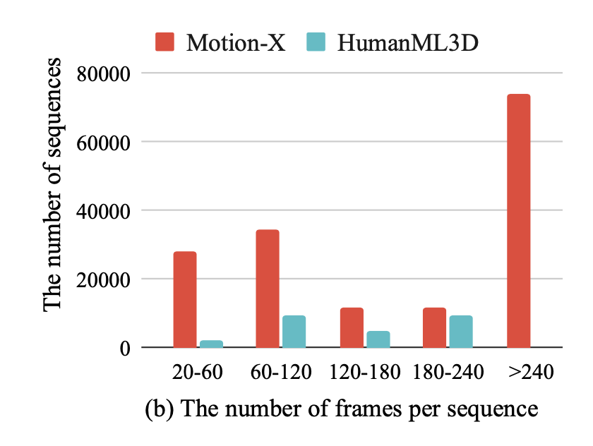
Dataset Overview
IDEA400: our record dataset, provides 12.5K motion sequences covering 400 diverse actions.
Online videos: 32.5K monocular videos from online source, covering real-life scenes. (We design action categories as motion prompts based on scenario and function of the action via LLM)

Slide 7
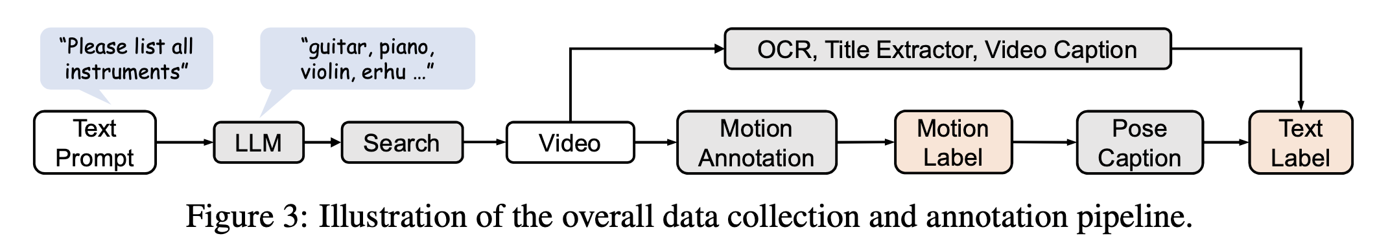
Data Collection and Annotation
6 key steps:
Designing and sourcing motion text prompts via LLM
Collection videos
Preprocessing candidate videos through human detection and video transition detection
Capturing whole-body motion
Captioning sequence-level semantic label & frame-level whole-body pose description
Performing the manual inspection
For existing datasets, skip step 1&2.
For AMASS, replace step 4 with facial augmentation.

Slide 8
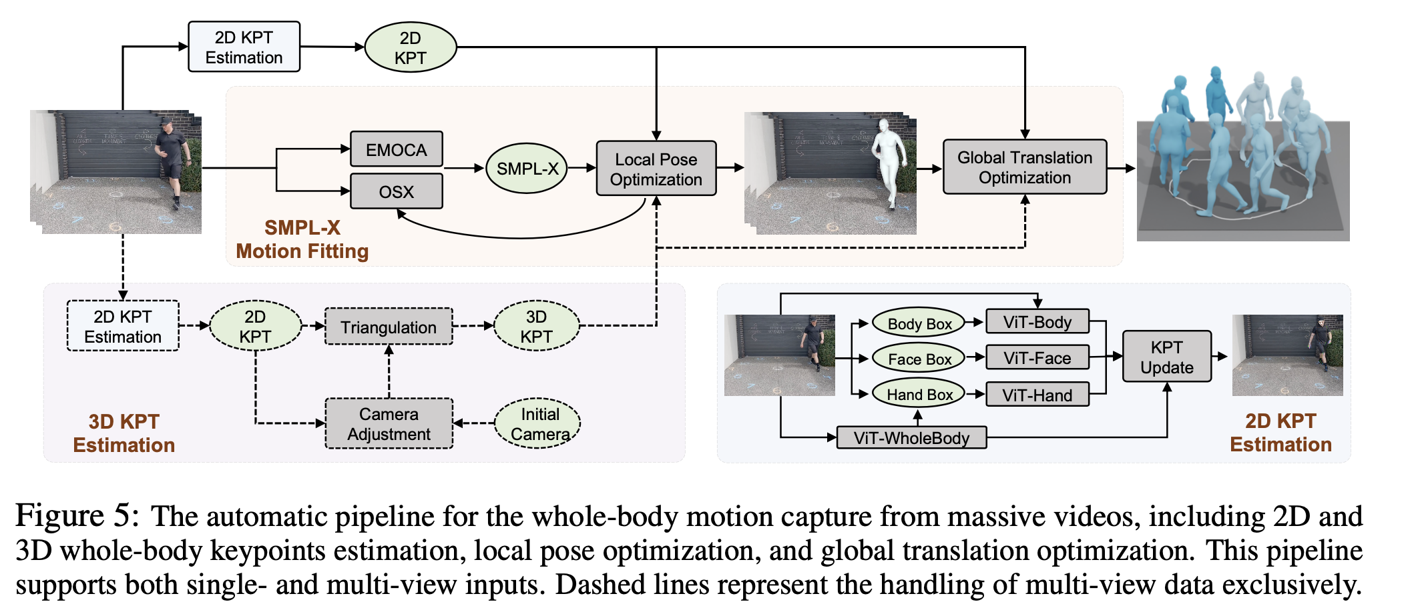
Motion Annotation Pipeline
3 novel techniques:
hierarchical whole-body keypoint estimation;
score-guided adaptive temporal smoothing for jitter motion refinement
learning-based 3D human model fitting for accurate motion capture.

Slide 9
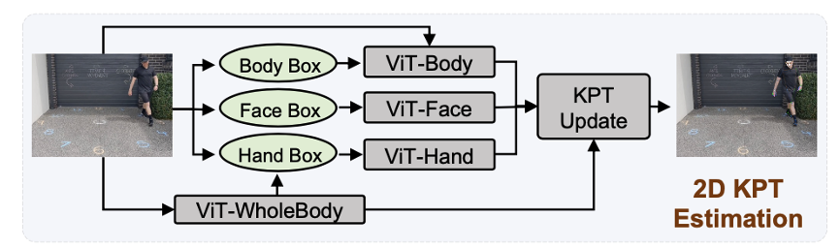
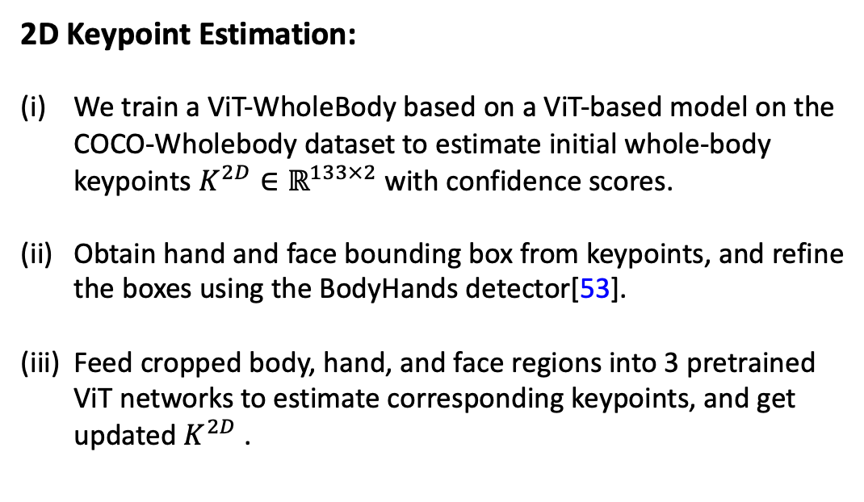
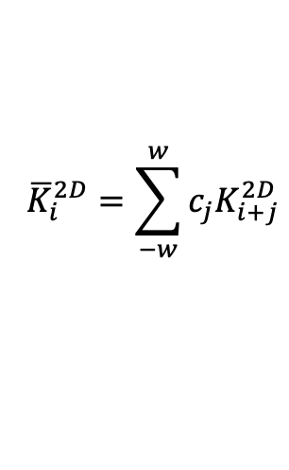
Motion Annotation Pipeline
2D Keypoint Estimation:
We train a ViT-WholeBody based on a ViT-based model on the COCO-Wholebody dataset to estimate initial whole-body keypoints $K^{2D}∈ℝ^{133×2}$ with confidence scores.
Obtain hand and face bounding box from keypoints, and refine the boxes using the BodyHands detector[53].
Feed cropped body, hand, and face regions into 3 pretrained ViT networks to estimate corresponding keypoints, and get updated $K^{2D}$ .
Score-guided Adaptive Smoothing :
Jiltters
Adaptive window size:
we leverage the confidence scores of the keypoints to adaptively adjust the window size to balance between smoothness and motion details.
Using a larger window size for keypoints with lower confidence scores can mitigate the impact of outliers.
$${\overline{K}}_{i}^{2D}=\sum_{−w}^{w}{c_{j}K_{i+j}^{2D}}$$

Slide 10
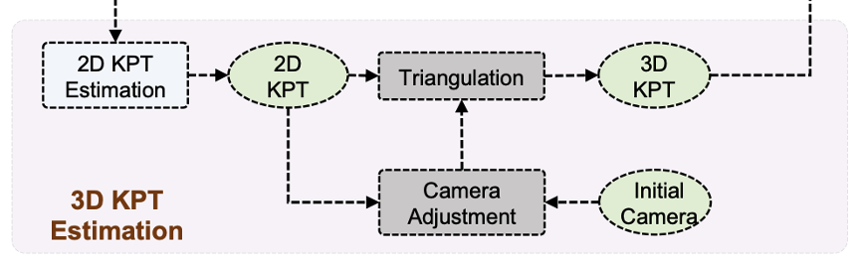

Motion Annotation Pipeline
3D Keypoint Estimation:
$${\overline{K}}_{i}^{3D}$$
For single view videos:
using a pretrained 3D keypoint estimation model [57]
For multi-view videos:
To enhance stability, we adopt temporal smoothing and enforce 3D bone length constraints during triangulation.

Slide 11


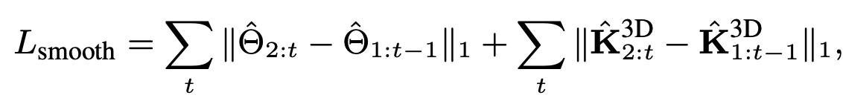
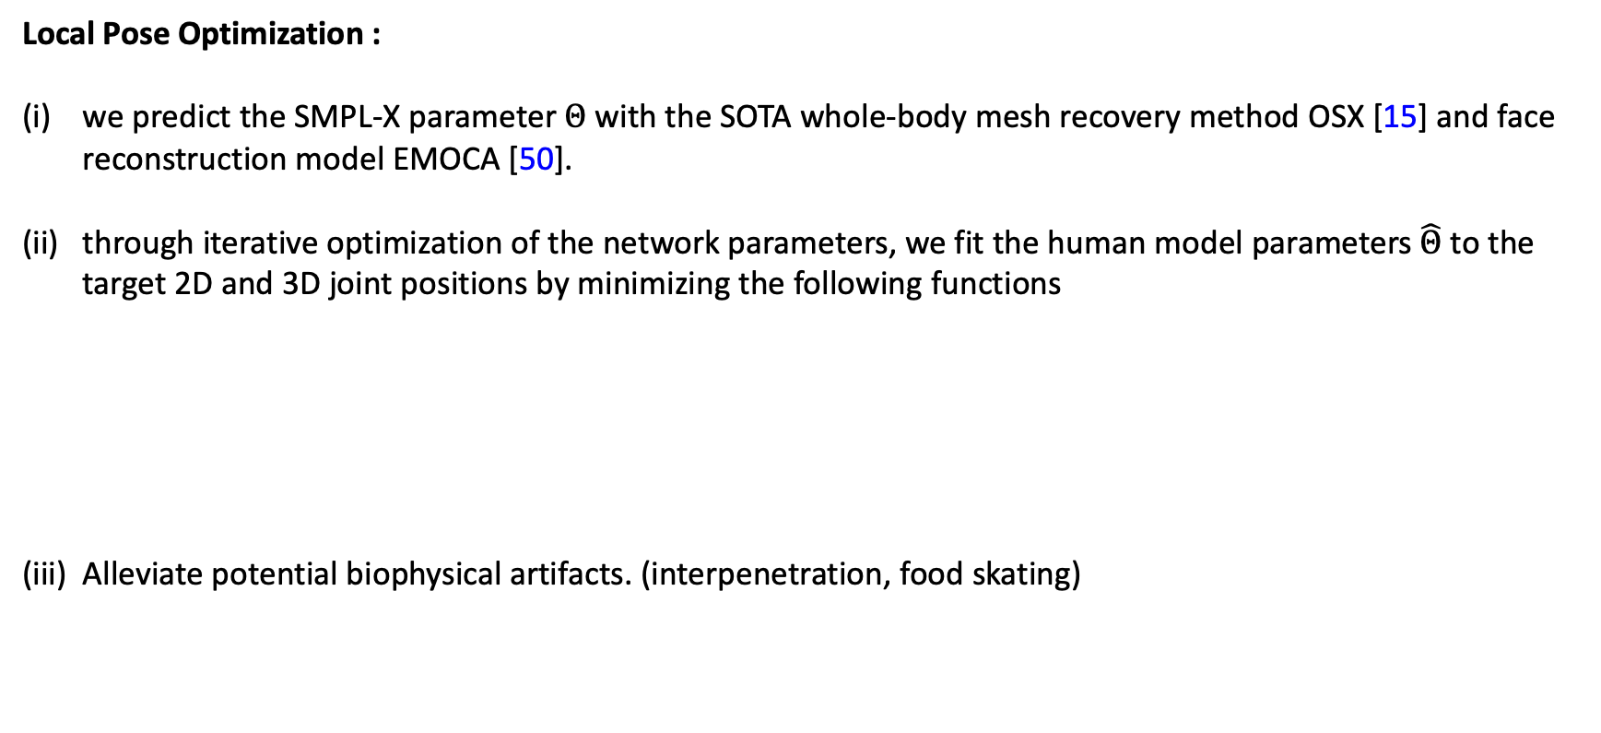
Motion Annotation Pipeline
Local Pose Optimization :
we predict the SMPL-X parameter $Θ$ with the SOTA whole-body mesh recovery method OSX [15] and face reconstruction model EMOCA [50].
through iterative optimization of the network parameters, we fit the human model parameters $\hat{Θ}$ to the target 2D and 3D joint positions by minimizing the following functions
Alleviate potential biophysical artifacts. (interpenetration, food skating)
the predicted 3D joint positions obtained by applying a linear regressor to a 3D mesh generated by the SMPL-X model.
derived by performing a perspective projection of the 3D keypoints
utilize a collision penalizer [59]
PhysCap [60] to prevent implausible poses

Slide 12


Motion Annotation Pipeline
Global Pose Optimization :
Aim: To improve the consistency and realism of the estimated global trajectory
we perform a global motion optimization based on GLAMR [19] to simultaneously refine the global motions and camera poses to align with video evidence, such as 2D keypoints
regularization on the global trajectory
2D keypoint distance loss
smoothness constraint on the camera parameters.
quantifies the difference between the optimized global trajectory and the trajectory estimated by Kama [61].

Slide 13

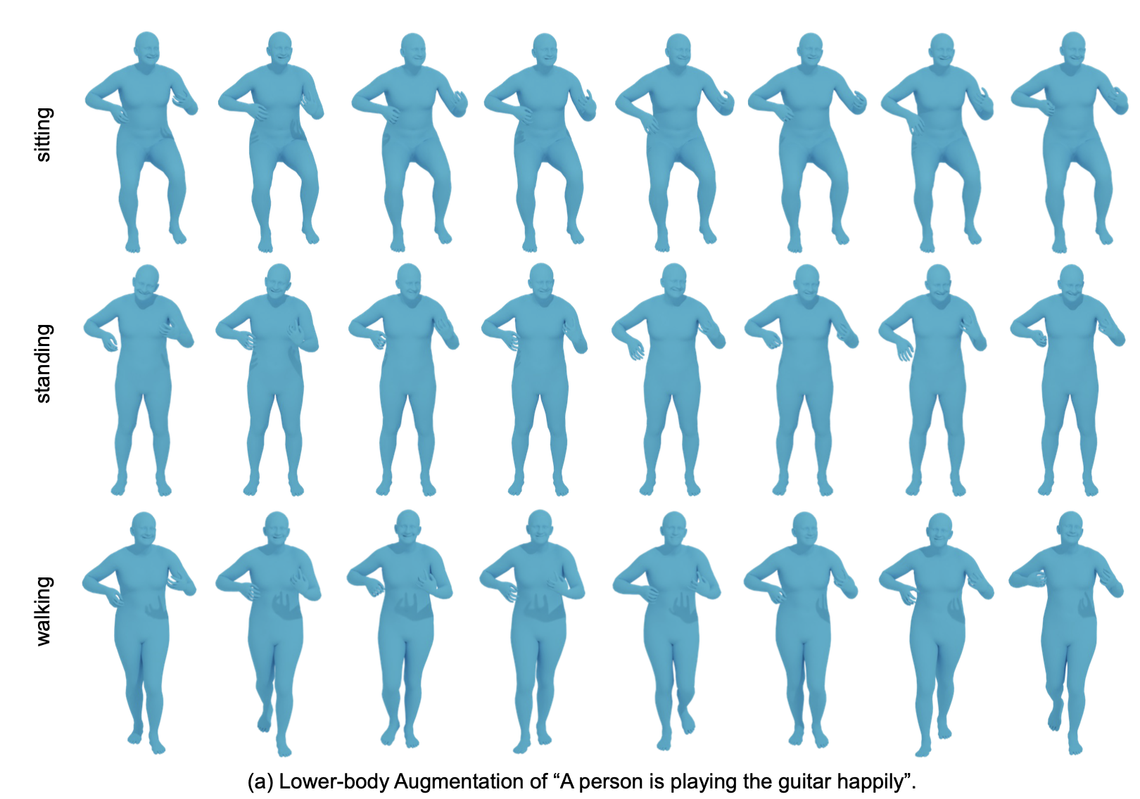
Motion Augmentation Mechanism
Lower-body Motion Augmentation

Slide 14
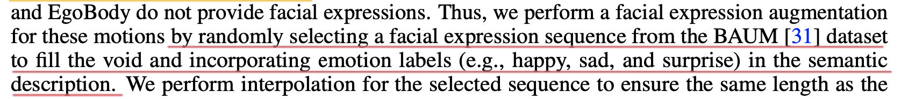
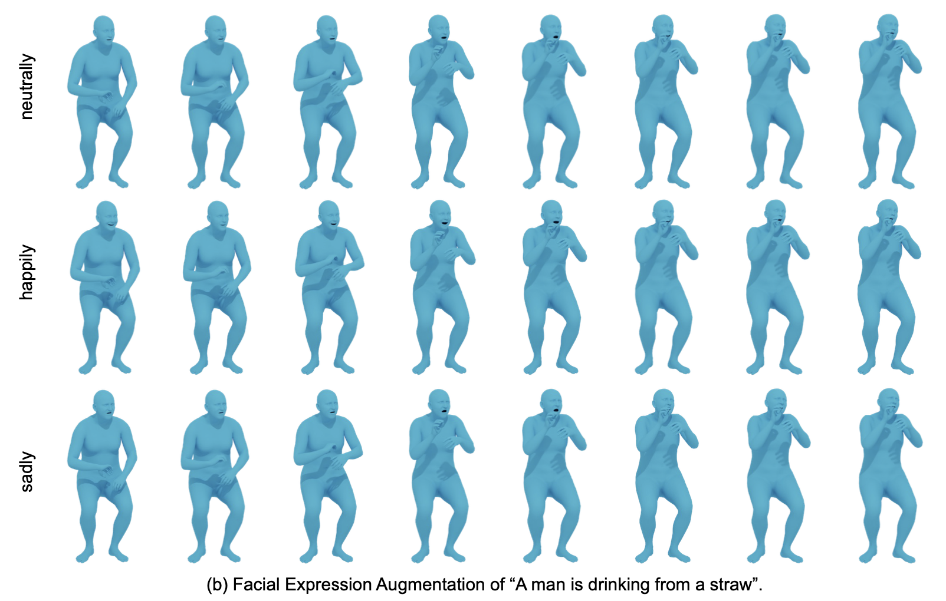
Motion Augmentation Mechanism
Facial Expression Augmentation

Slide 15
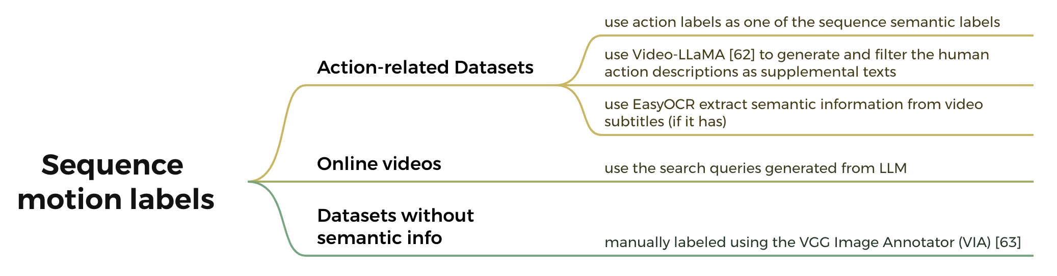
Obtaining Whole-body Motion Descriptions
Sequence motion labels.

Slide 16
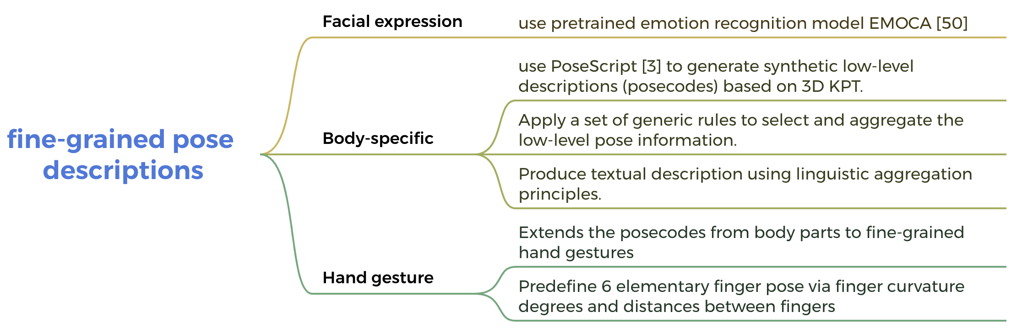
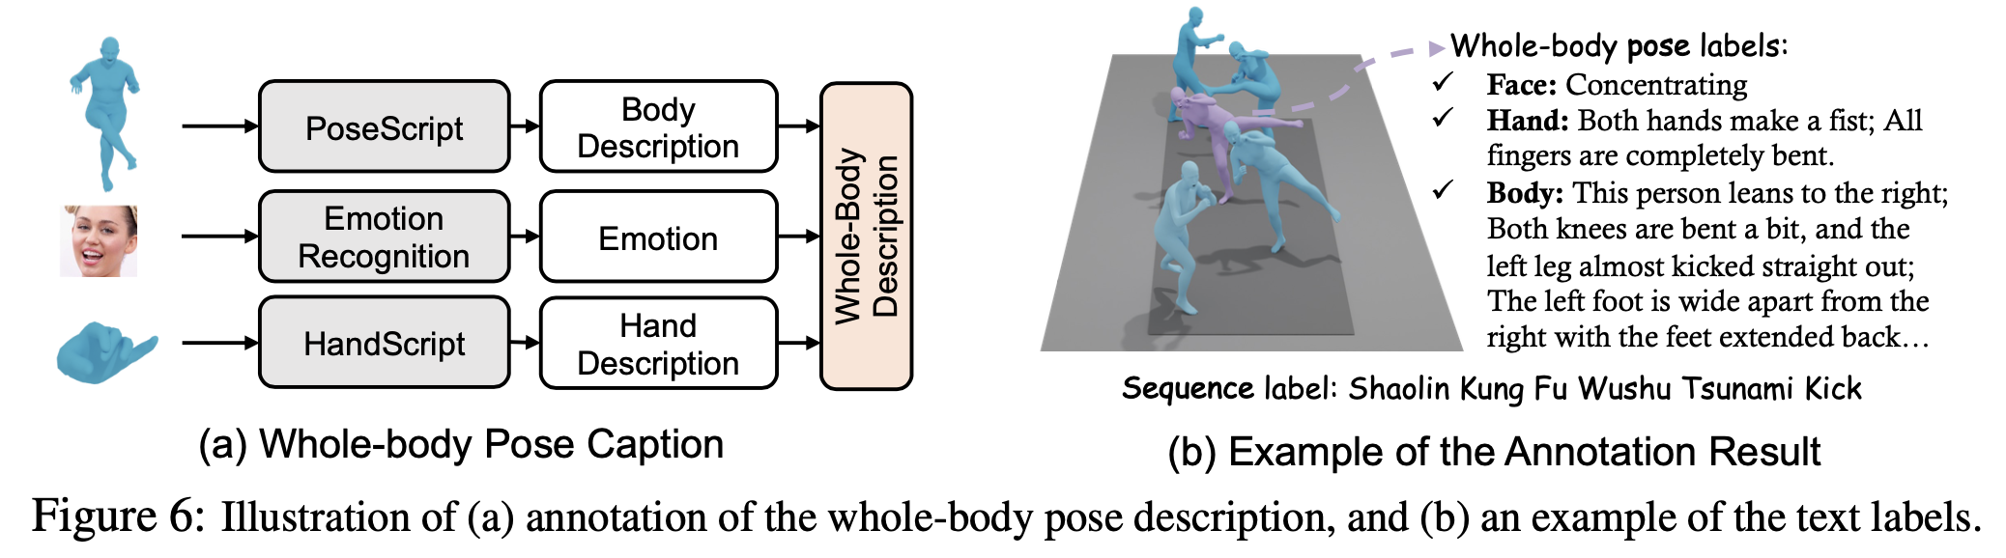
Obtaining Whole-body Motion Descriptions
Whole-body pose descriptions.

Slide 17

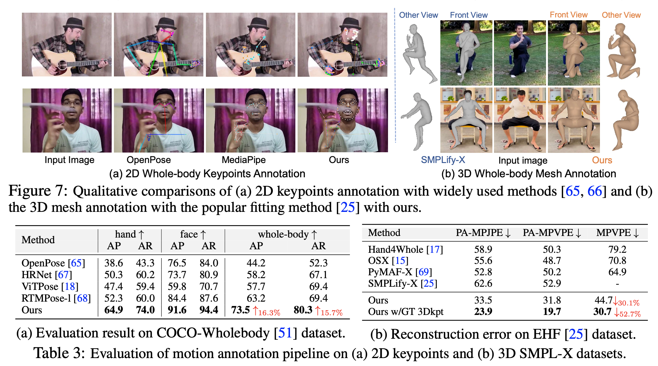
Experiments

Slide 18
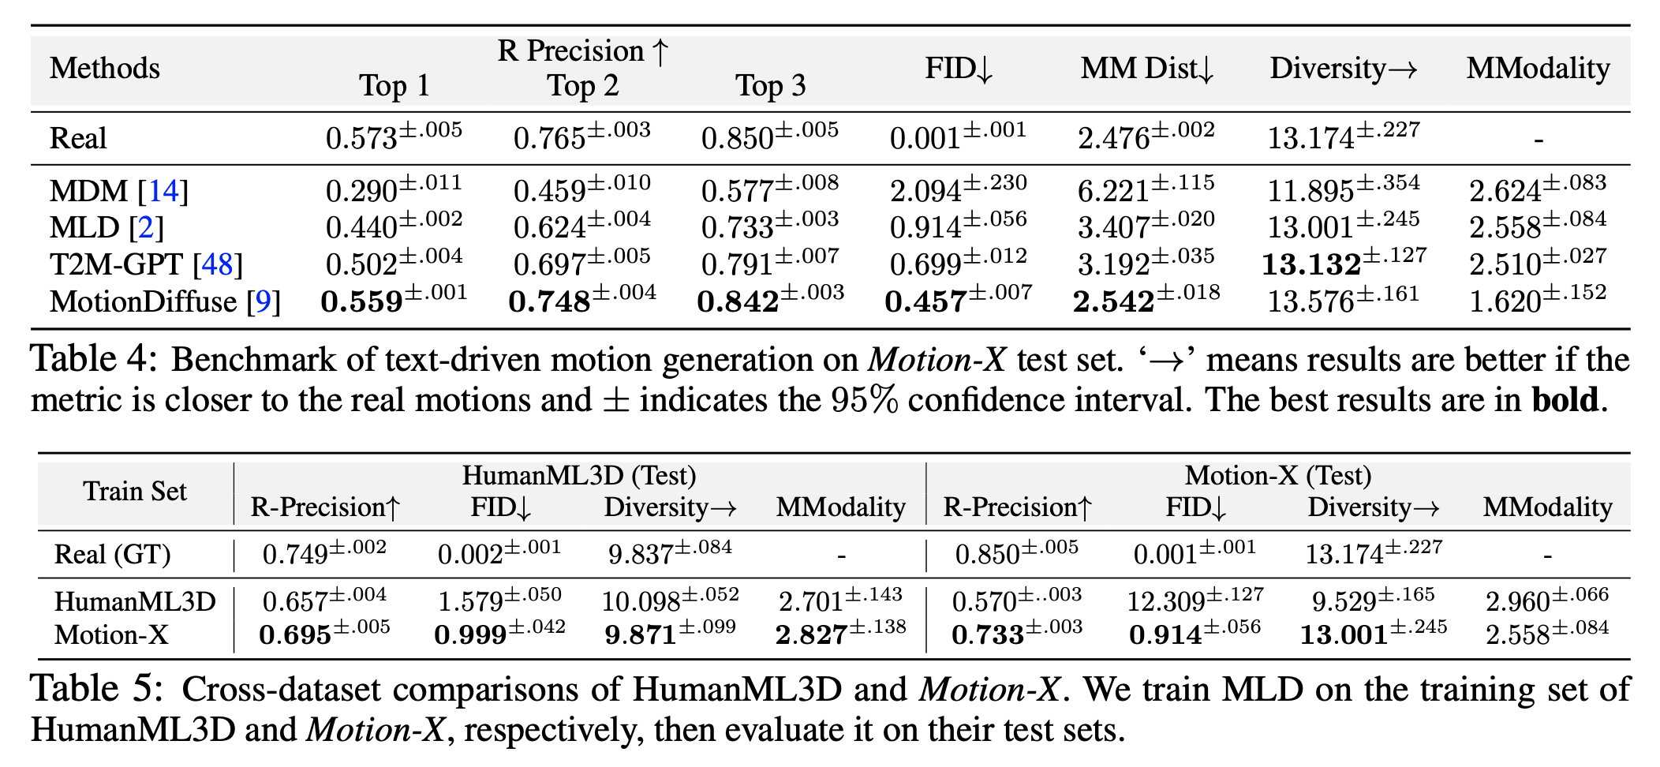
Experiments

Slide 19
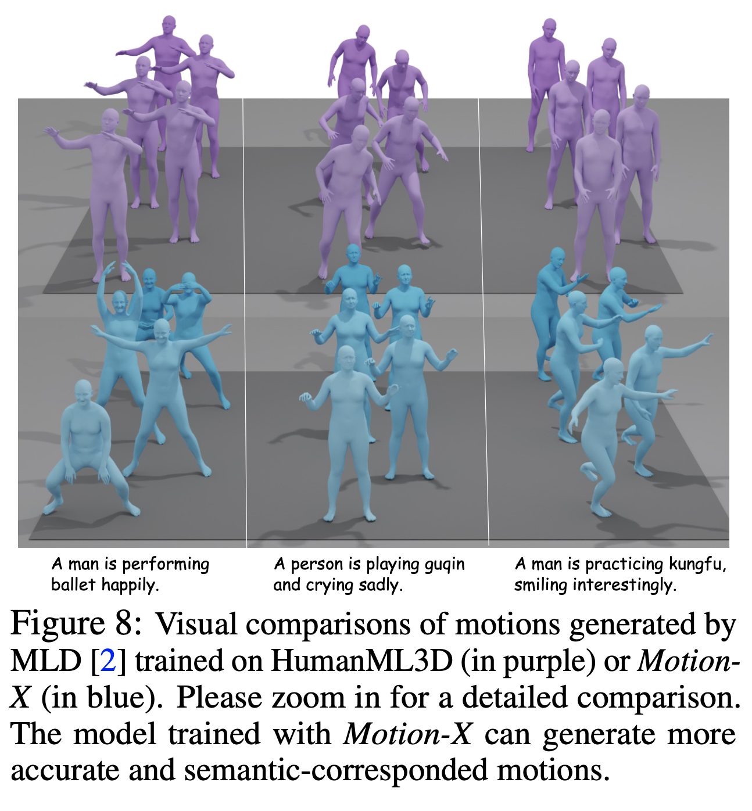
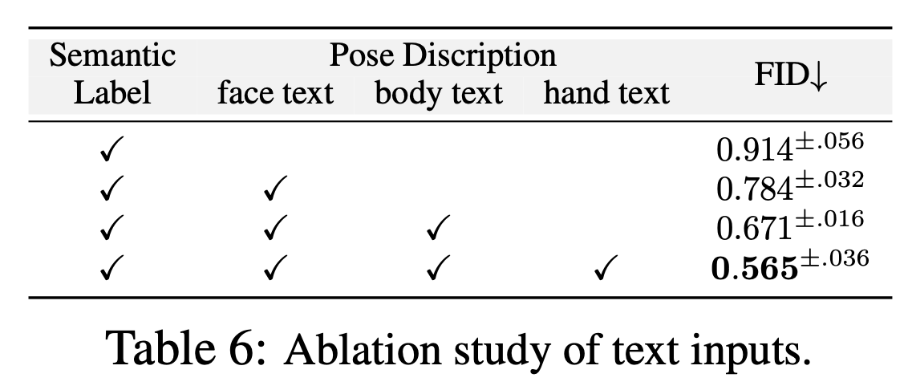
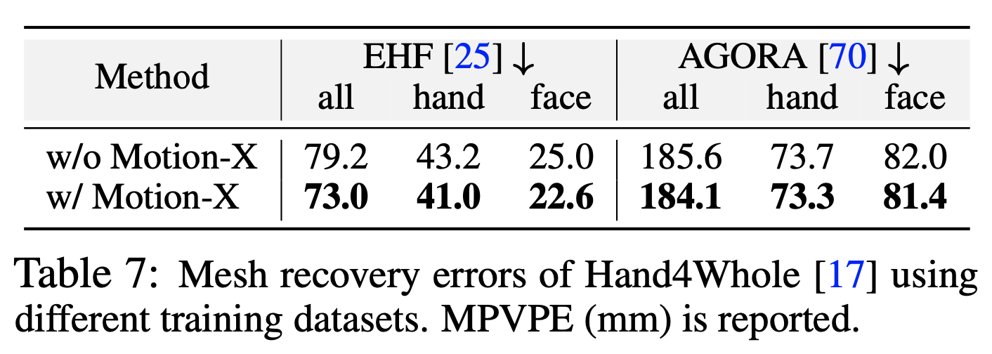
Experiments

Slide 20
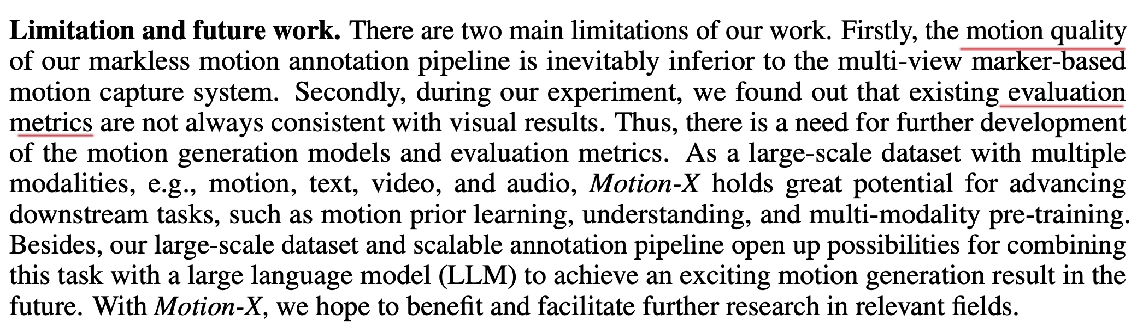
Limitation and future work

